Slide 1
What Do I Do With A Worry?
This Photo by Unknown Author is licensed under CC BY-NC-ND

Slide 2
A message from my dog Daisy

Slide 3
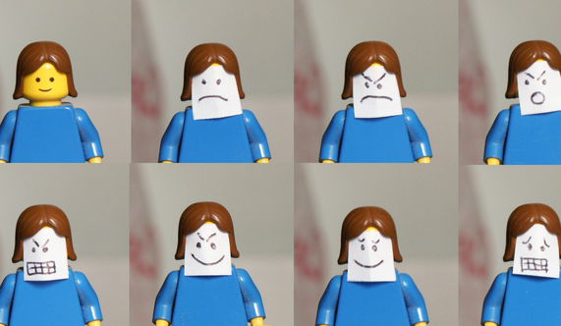
FEELINGS CHANGE
Everyone feels worried sometimes, especially with all the changes happening right now.
It’s OK to feel worried. Remember you won’t feel worried forever. Feelings change all the time and there are things you can do to help you get over feeling worried.
This Photo by Unknown Author is licensed under CC BY-ND

Slide 4
How your body might feel when you feel worried
Your heart might beat faster

Slide 5
You might get a tummy ache

Slide 6
You might feel any of these things:

Slide 7
But you can get over feeling worried
You can take deep breaths

Slide 8
You can talk to a friend or trusted adult about your feelings

Slide 9
You can think happy thoughts like your favorite toys or place to be

Slide 10
You can make a worry box
Decorate a box or a bag any way you like. When you have a worry, draw a picture of it or write about it. Put it in the box and let the box do the worrying for you!

Slide 11
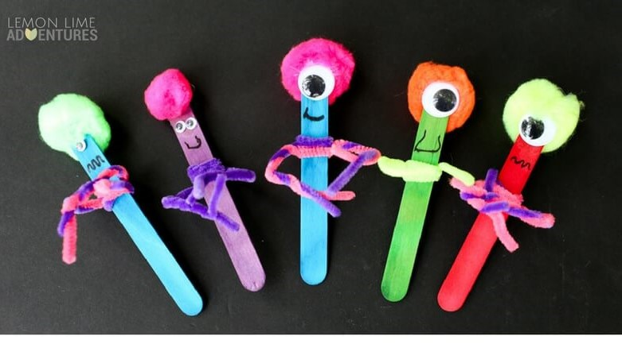
You can make a worry monster
Tell your worries to your worry monster and let it do the worrying for you!

Slide 12
Remember:
It’s OK to feel worried
You won’t feel like this forever
Feelings change
You can make yourself feel better

Slide 13
Daisy and I are always here for you!!

